Slide 1
8086 Microprocessor
8086

Slide 2
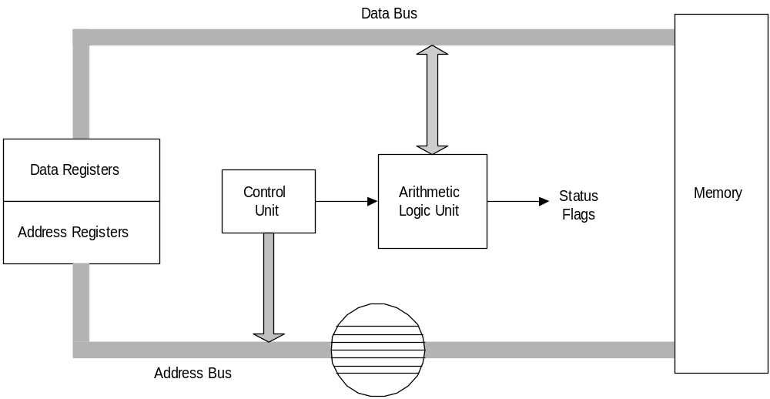
Simplified CPU Design
8086

Slide 3
8086 Features
8086
16-bit Arithmetic Logic Unit
16-bit data bus (8088 has 8-bit data bus)
20-bit address bus - 2²⁰ = 1,048,576 = 1 M
Follows CISC architecture
The address refers to a byte in memory. In the 8088, these bytes come in on the 8-bit data bus.
  In the 8086, bytes at even addresses come in on the low half of the data bus (bits 0-7) and bytes at odd addresses come in on the upper half of the data bus (bits 8-15)..
The 8086 can read a 16-bit word at an even address in one operation and at an odd address in two operations. The 8088 needs two operations in either case.
The least significant byte of a word on an 8086 family microprocessor is at the lower address. This is known as Little Endian Format

Slide 4
Intel 8086 Microprocessors
8086
8086 consists of two internal units
  The execution unit (EU) - executes the instructions
  The bus interface unit (BIU) - fetches instructions, reads operands and writes results
The 8086 has a 6B prefetch queue
The 8088 has a 4B prefetch queue

Slide 5
Flag Register
8086
Conditional flags:
  They are set according to some results of arithmetic operation. You do not need to alter the value yourself.
Control flags:
  Used to control some operations of the MPU. These flags are to be set by you in order to achieve some specific purposes.
Flag |  |  |  |  | O | D | I | T | S | Z |  | A |  | P |  | C
Bit no. | 15 | 14 | 13 | 12 | 11 | 10 | 9 | 8 | 7 | 6 | 5 | 4 | 3 | 2 | 1 | 0
Carry
Parity
Overflow
Auxiliary
Zero
Sign
Direction
Trap
6 are status flags
3 are control flag
Interrupt
enable

Slide 6
Flag
8086
CF (carry) Contains carry from leftmost bit following arithmetic, also contains last bit from a shift or rotate operation.
OF (overflow) Indicates overflow of the leftmost bit during arithmetic.
DF (direction) Indicates left or right for moving or comparing string data.
IF (interrupt) Indicates whether external interrupts are being processed or ignored.

Slide 7
Flags
8086
TF (trap) Permits operation of the processor in single step mode
SF (sign) Contains the resulting sign of an arithmetic operation (1=negative)
ZF (zero) Indicates when the result of arithmetic or a comparison is zero. (1=yes)
AF (auxiliary carry) Contains carry out of bit 3 into bit 4 for specialized arithmetic.
PF (parity) Indicates the number of 1 bits that result from an operation.

Slide 8
Segment Registers - CS, DS, SS & ES
8086
Are Address registers
Store the memory addresses of instructions and data
Memory Organization
  Each byte in memory has a 20 bit address starting with 0 to 220-1 or 1 meg of addressable memory
  Addresses are expressed as 5 hex digits from 00000 - FFFFF
  Problem: But 20 bit addresses are TOO BIG to fit in 16 bit registers!
  Solution: Memory Segment
    Block of 64K (65,536) consecutive memory bytes
    A segment number is a 16 bit number
    Segment numbers range from 0000 to FFFF
    Within a segment, a particular memory location is specified with an offset
    An offset also ranges from 0000 to FFFF

Slide 9

Segmented Memory
8086
Segment addresses 64K of memory
A segmented register contains the starting address of a segment
  The absolute address can be determined by appending a hexadecimal zero
A offset is the distance from the beginning of the segment to a particular instruction or variable.
Segmented memory addressing:
  absolute (linear) address is a combination of a 16-bit segment value added to a 16-bit offset

Slide 10
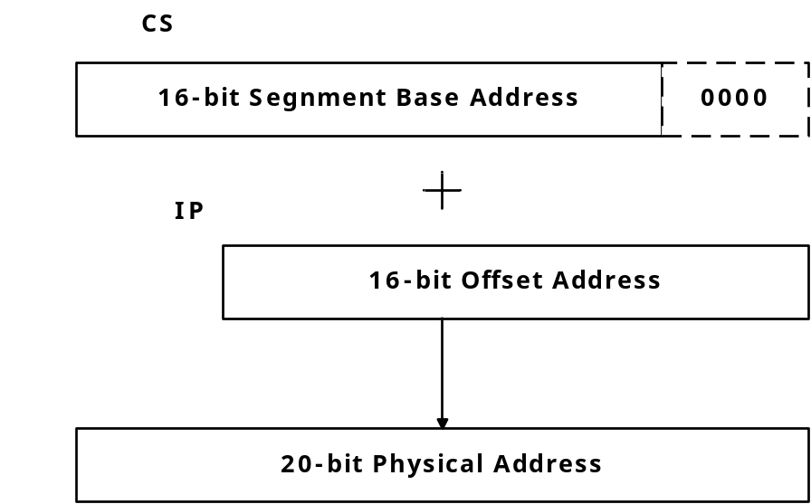
8086 20-bit Addresses
8086
Logical Address is specified as segment:offset
Physical address is obtained by shifting the segment address 4 bits to the left and adding the offset address
Thus the physical address of the logical address A4FB:4872 is
      A4FB0
      + 4872
      A9822
The physical address is also called the absolute address.

Slide 11
8086
Code Segment
_{0H}
4000H
CS:
0400H
IP
0056H
4056H
CS:IP = 400:56
Logical Address
Memory
0400
0
Segment Register
Offset
Physical or
Absolute Address
+
0056
04056H
_{0FFFFFH}
The offset is the distance in bytes from the start of the segment.
The offset is given by the IP for the Code Segment.
Instructions are always fetched with using the CS register.

Slide 12
8086
Data Segment
_{0H}
05C00H
DS:
05C0
05C50H
EA
0050
DS:EA
Memory
05C0
0
Segment Register
Offset
Physical Address
+
0050
_{0FFFFFH}
05C50H
Data is usually fetched with respect to the DS register.
The effective address (EA) is the offset.
The EA depends on the addressing mode.

Slide 13
8086
Stack Segment
_{0H}
0A00
0A000H
SS:
0A100H
SP
0100
SS:SP
Memory
0A00
0
Segment Register
Offset
Physical Address
+
0100
0A100H
_{0FFFFFH}
The offset is given by the SP register.
The stack is always referenced with respect to the stack segment register.
The stack grows toward decreasing memory locations.
The SP points to the last or top item on the stack.
PUSH - pre-decrement the SP
POP - post-increment the SP

